Slide 1
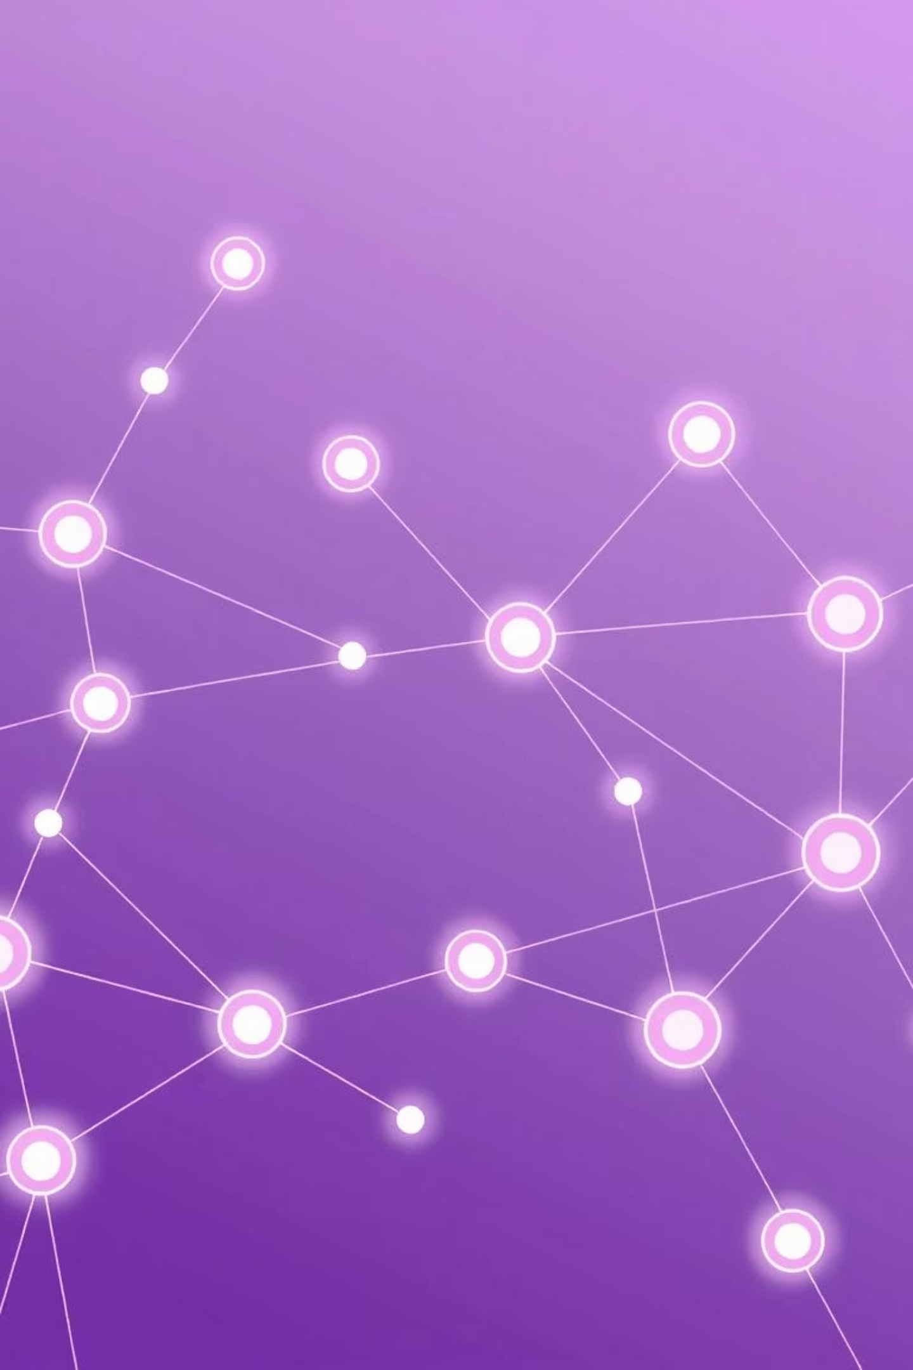
Cardano NFT Minting Website: Your Gateway to Digital Collectibles
Imagine a world where anyone can create, own and showcase unique digital collectibles in just a few clicks. That's the vision driving our project: a beginner-friendly NFT minting website built on the Cardano blockchain.
I worked on making the website connect with Cardano wallets, which is basically letting users log in securely and interact with the blockchain.
TEAM NAME: Cardano Commandos
MEMBERS:
E.ANJALI
D.MANASA
D.DATTU

Slide 2
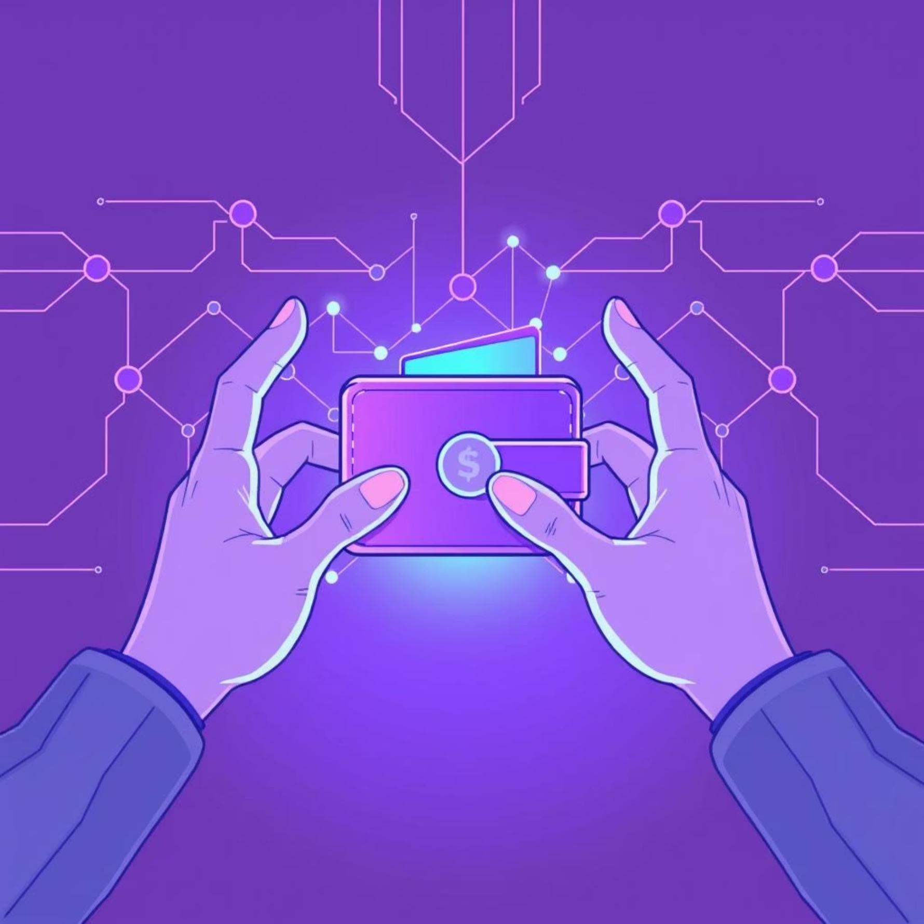




Seamless User Experience: Connecting to Cardano
Our primary goal is to simplify NFT creation. The journey begins with a secure and straightforward wallet connection, crucial for blockchain interaction. Users can effortlessly link their preferred Cardano wallets Nami, Eternl or Lace to the platform.
Once connected, a single "Mint NFT" button triggers the creation of a unique digital asset. Users can then view their newly minted NFTs directly in their wallet or through an optional on-site gallery, providing a seamless and engaging experience. All of this operates on the Cardano Preprod Testnet, offering a safe, sandboxed environment for testing and learning.
Identity & Ownership
Secure Transactions
Your wallet acts as your digital ID, proving ownership.
Only your wallet can approve blockchain interactions.
NFT Storage
Safe Interaction
Minted NFTs are securely stored and accessible via your wallet.
Every blockchain action requires explicit wallet approval.

Slide 3

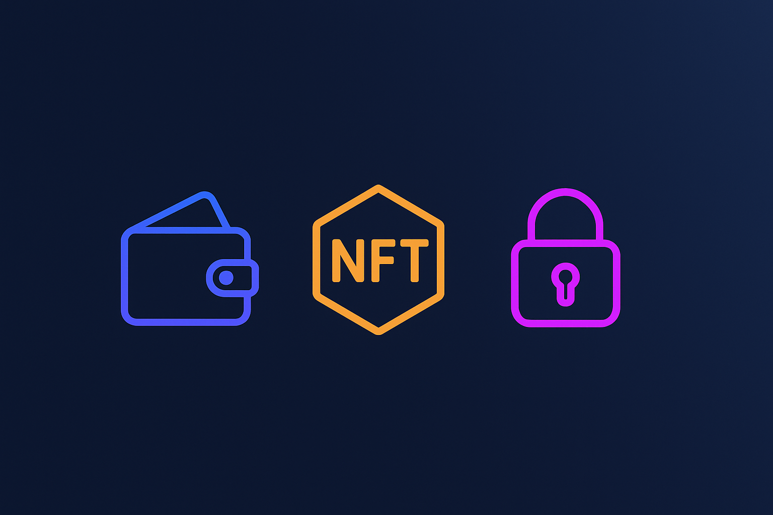
Understanding NFTs: Beyond Digital Art
Non-Fungible Tokens (NFTs) are unique digital collectibles, verifiable on the blockchain.
They represent a new paradigm for digital ownership and utility.
True Ownership
Blockchain technology definitively proves who owns a digital asset.
Collectibles & Display
Showcase unique digital art, music, or other digital items.
Investment Potential
Some NFTs can appreciate in value, offering speculative investment opportunities.
Exclusive Access
NFTs can unlock VIP features, events, or in-game content.
"Owning an NFT is like owning a piece of the internet's future – a verifiable, unique digital asset that opens doors to new possibilities."

Slide 4




The Minting Journey: From Click to Collectible
Our platform streamlines the NFT minting process into intuitive steps, making it accessible for everyone.
Connect Wallet
Mint NFT
View NFT
Initiate the process by clicking "Connect Wallet." A secure pop-up will request permission to link your chosen Cardano wallet (Nami, Eternl, or Lace). This is your digital handshake with the blockchain.
Select or upload a simple image and provide relevant metadata. With a single click on "Mint NFT," your unique digital asset is created on the Cardano Preprod Testnet, ready to be recognized on the blockchain.
Your newly minted NFT will instantly appear in your connected wallet. For convenience, you can also view it within our website's optional gallery, showcasing your creation alongside others.

Slide 5
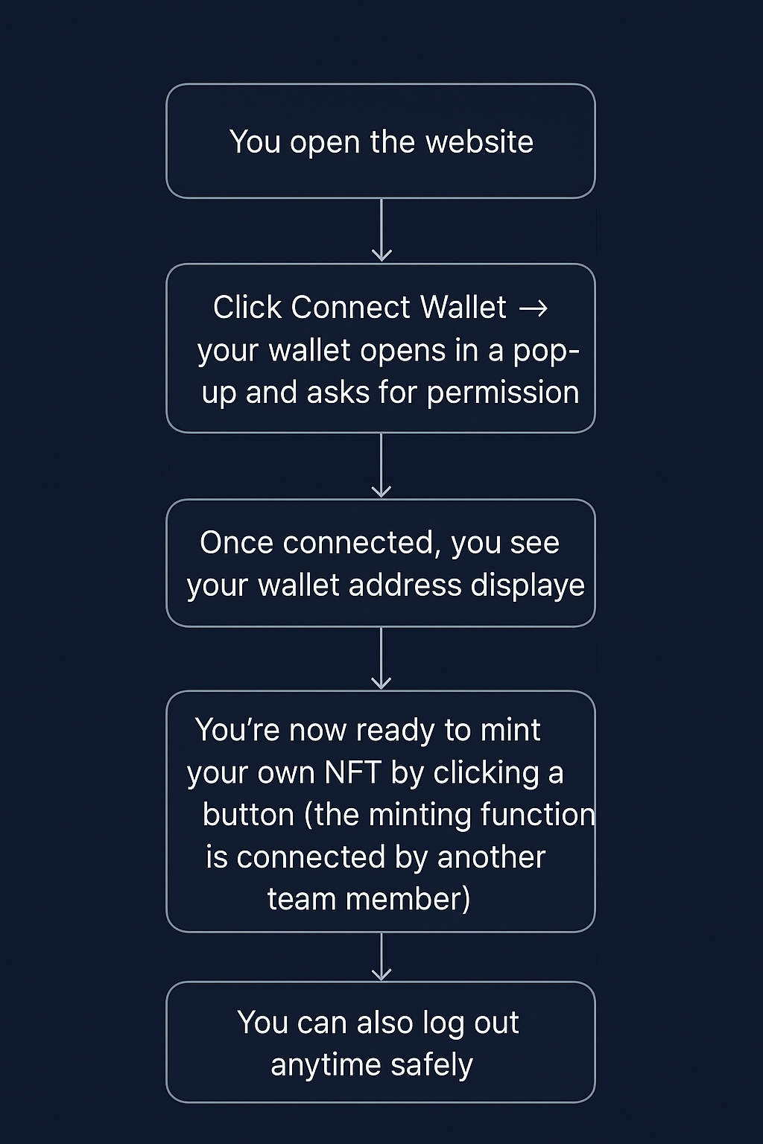
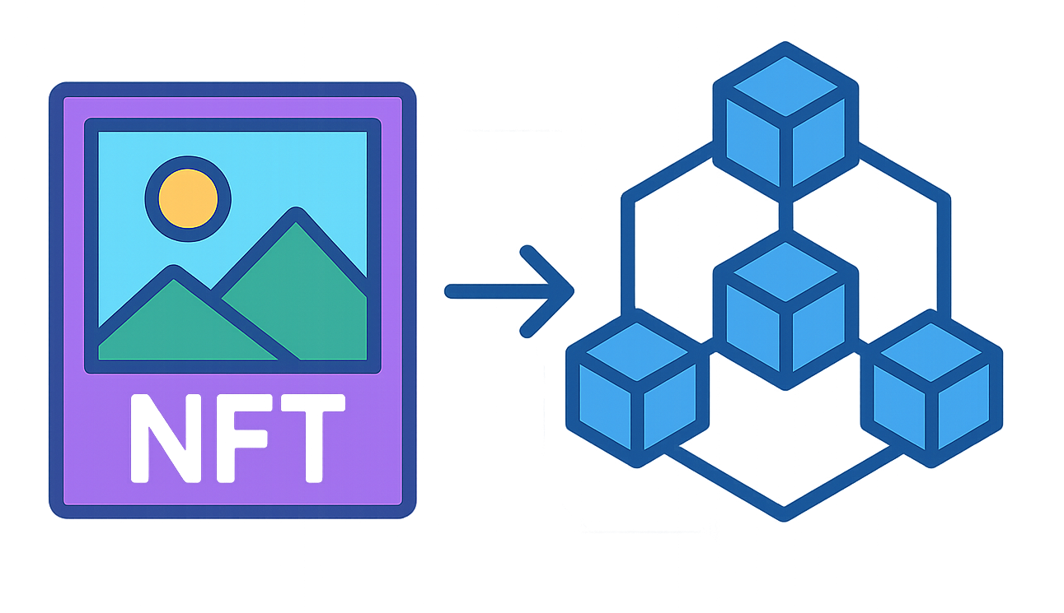
FLOWCHART & DIAGRAM

Slide 6
Tech Foundation & Project Impact
Our project stands on a robust and modern tech stack, meticulously chosen to deliver a seamless and secure experience for every user.
Key Technologies
Why It Matters
Frontend: React + Tailwind CSS for a fast, responsive UI.
User-Friendly: Anyone can mint NFTs without coding knowledge.
Wallet Connection: MeshJS for secure Cardano wallet integration.
Secure: Wallet connections protect funds and digital assets.
NFT Minting: Guided by MeshJS and a comprehensive guide.
Blockchain: Cardano Preprod Testnet for safe, cost-free testing.
Educational: Demonstrates real blockchain interaction clearly.
API: Blockfrost for seamless communication with Cardano.
Creative & Fun: Empowers users to create unique digital collectibles.
Deployment: Vercel / Netlify to make the website live and accessible.
Conclusion: Bridging the Gap to Digital Collectibles
We've built a fast, interactive and beginner-friendly NFT platform that simplifies the entire process: from secure wallet connection to instant NFT minting and viewing. This project empowers creators and collectors to experience the full potential of the Cardano blockchain in a safe, understandable and engaging way.

Slide 7
